Slide 1

Leveraging Machine Learning for Fraud Detection by Strengthening Online Payment Security
By
G K SAI MOHITHA (209E1A3323)
NAGURU SAI PREETHI (209E1A3343)
THATIPARTHI SUPRIYA (209E1A3361)
Under the guidance of
D.LAVANYA (M.Tech)
Assistant Professor
DEPARTMENT OF COMPUTER SCIENCE AND ENGINEERING (AI & ML)
SRI VENKATESWARA ENGINEERING COLLEGE
(Affilated to JNTUA,Ananthapuramu)
Karakambadi Road, Tirupati-517507
2020-2024

Slide 2
OUTLINE
Abstract
Introduction
Problem Statement
Existing system
Disadvantages
Proposed system
Advantages
System Requirements
Modules
Diagrams
Coding
Testing
Execution
Screenshots
Conclusion
References

Slide 3
ABSTRACT
People rely on online transactions for nearly everything in today’s environment. Online transactions offer several benefits, such as ease of use, viability, speedier payments, etc., but they also have some drawbacks, such as fraud, phishing, data loss, etc. As online transactions grow, there is a continuing risk of frauds and deceptive transactions that could violate a person’s privacy. In order to prevent high risk transactions we use machine learning algorithms. This research study has introduced a feature-engineered machine learning-based model for detecting transaction fraud.

Slide 4
INTRODUCTION
As online transactions grow, there is a continuing risk of frauds and deceptive transactions that could violate a person’s privacy. In order to prevent high risk transactions, numerous commercial banks and insurance firms invested millions of rupees in the development of transaction detection systems.
In order to overcome this research study has introduced a feature-engineered machine learning-based model for detecting transaction fraud.

Slide 5
PROBLEM STATEMENT
The rise of online transactions has revolutionized commerce, providing convenience and accessibility to consumers worldwide. However, this convenience comes with inherent risks, as cybercriminals exploit vulnerabilities in online payment systems to perpetrate fraudulent activities.
Fraudulent transactions not only result in financial losses for businesses but also erode consumer trust in online payment platforms. The rise of online transactions has revolutionized commerce, providing convenience and accessibility to consumers worldwide.

Slide 6
EXISTING SYSTEM
In the existing system for fraud detection in online payment using machine learning, traditional rule-based systems and heuristic approaches are often employed to identify potentially fraudulent transactions.
These systems typically rely on predefined rules and thresholds to flag transactions that exhibit suspicious behavior, such as large transactions, unusual purchase patterns, or transactions from high-risk locations.

Slide 7
DISADVANTAGES
False positives can result in transaction declines and customer dissatisfaction, while false negatives can allow fraudulent activities to go undetected, undermining the effectiveness of the fraud detection system.
Fraudsters continuously adapt their tactics and techniques to evade detection, making it difficult for static machine learning models to keep pace with emerging fraud patterns.
Machine learning algorithms may struggle to generalize well to new and unseen fraud scenarios, leading to reduced detection accuracy and reliability over time.

Slide 8
PROPOSED SYSTEM
In the proposed system for fraud detection in online payment using machine learning, advanced machine learning algorithms are leveraged to detect fraudulent transactions in real-time with greater accuracy and efficiency.
The system utilizes supervised learning techniques such as logistic regression, decision trees, random forests, and neural networks to analyze large volumes of transaction data and identify patterns indicative of fraudulent behavior

Slide 9
ADVANTAGES
The Machine learning algorithms can analyze large volumes of transaction data in real-time, allowing for more timely and accurate detection of fraudulent activities.
The Fraud detection systems have the capability to adapt and evolve over time to address emerging fraud trends and evolving attack vectors.
Adaptability and flexibility make machine learning-based fraud detection systems well-suited for the dynamic and rapidly changing landscape of online payment fraud.

Slide 10
SYSTEM REQUIREMENTS
Hardware Requirements :
System : Pentium IV 2.4 GHz RAM : 512 MB
Hard disk : 40 GB Monitor : 15 inch VGA Color Keyboard : Standard Keyboard
Mouse : Logitech Mouse

Slide 11
SOFTWARE REQUIREMENTS
Operating System : Windows XP
Platform : Python Technology
Tool : Python 3.6
Front end : Python anaconda script
Back end : Spyder

Slide 12
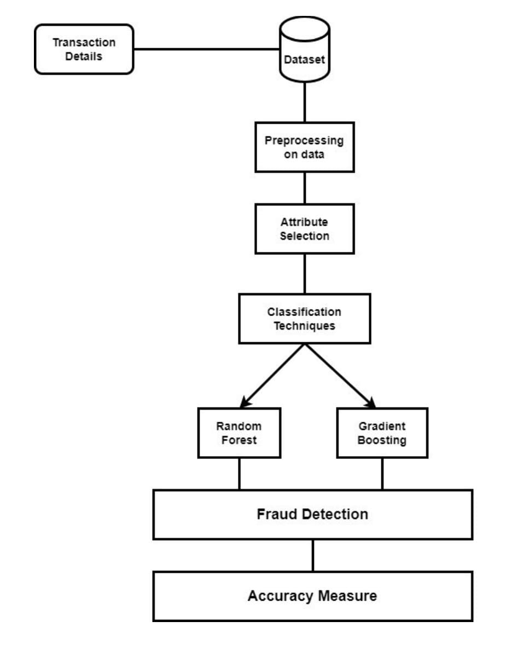
ARCHITECTURE

Slide 13
MODULES
Data Collection and Preprocessing
Feature Extraction and Selection
Machine Learning Model Training
Model Evaluation and Validation

Slide 14
MODULES
Data Collection and Preprocessing:
This module involves collecting transaction data from various sources, such as payment gateways, financial institutions, and online merchants.
The data collected may include transaction timestamps, transaction amounts, user demographics, and behavioral features.
Feature Extraction and Selection:
In this module, relevant features are extracted from the transaction data to capture meaningful patterns and characteristics.
Feature extraction techniques may include statistical measures, time series analysis, and behavioral profiling.

Slide 15
MODULES
Machine Learning Model Training:
This module involves training machine learning algorithms using historical transaction data labeled as fraudulent or legitimate.
Supervised learning algorithms such as logistic regression, decision trees, random forests, support vector machines, and neural networks.
Model Evaluation and Validation:
In this module, the performance of the trained machine learning models is evaluated using metrics such as accuracy, precision.
The models are validated using cross-validation techniques to assess their generalization ability and robustness to unseen data.

Slide 16
Use Case Diagram
Collect Data Set
StopWord Removal
Stemming Word Removal
Train Data Using CNN
NewClass2
NewClass
Build Flask Application
Input Data
Input Prediction

Slide 17
Sequence Diagram
Data Set
Data Set
StopWord
StopWord
Stemming
Stemming
Positive Word
Train Data
Using CNN
Negative Word
Build Flask
Application
Frequency
Prediction
Removal
Removal
Word Removal
Word Removal
Removal
Removal
Data Set Collection using Google
Sentiment analysis with data
Predictive model deployment used by data scientists
Stem Porter operator reduces the length of the
Apply Model operator
Fraud detection
in online payment

Slide 18
Collaborative Diagram
1: Data Set Collection using Google
2: Sentiment analysis with data
Data Set
Transaction
Data
ML_ Algorithm
6: Fraud detection in
online payment
3: Predictive model deployment used by data scientists
4: Stem Porter operator reduces the length of the
5: Apply Model operator
Train Data
Using CNN
Build Flask
Application
Prediction

Slide 19
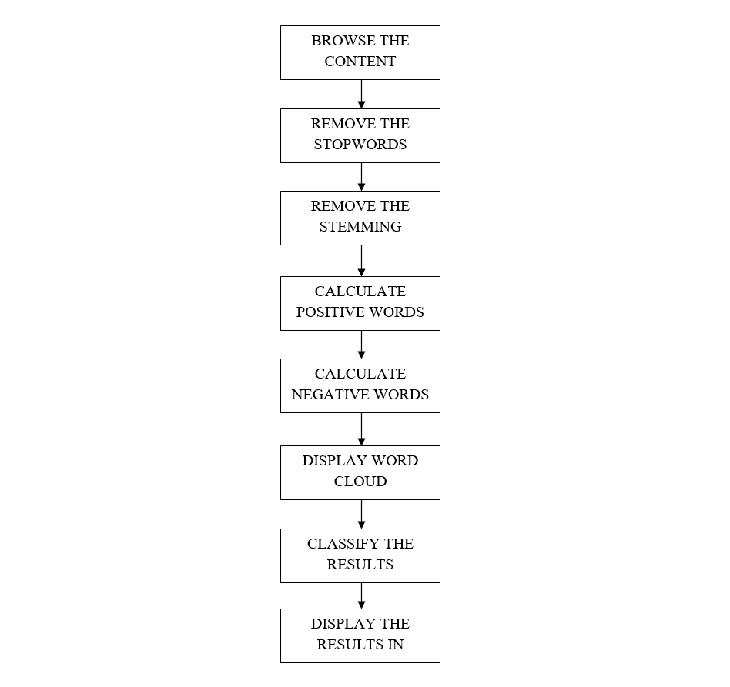
Data Flow Diagram

Slide 20
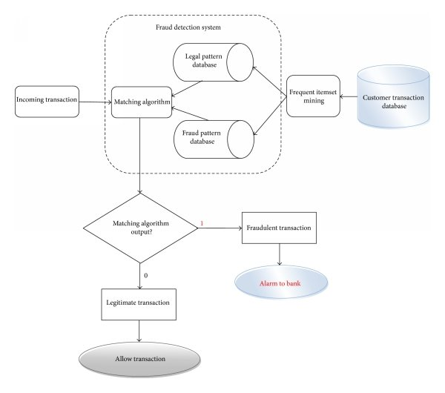
Activity Diagram

Slide 21
Coding
import NumPy as np #linear algebra
Import pandas as pd #data processing CSV file I/O
import os
for dirname, _, filenames in os.walk('D:/2024/online payment fraud'):
for filename in filenames:
print(os.path.join(dirname, filename))
Import pandas as pd #importing requires Libraries
Import NumPy as np
Import matplotlib.pyplot as plt
df = pd.read_csv("D:/2024/data.csv") #loading the dataset into pandas dataframe
df
#retain the 6 features and the target variable
df=df[['amount','oldbalanceOrg','newbalanceOrig','oldbalanceDest','newbalanceDest',"isFraud","isFlaggedFraud"]]
df.info()
df.isnull().sum()
df['isFraud'].value_counts()
X = df.drop('isFraud',axis=1) #load features to a variable x
y = df['isFraud’]

Slide 22
from sklearn.model_selection import train_test_split #Do the train/test split
X_train,X_test,y_train,y_test = train_test_split(X,y,test_size=0.30,random_state=1)
from sklearn.linear_model import LogisticRegression #Train the logistic regression model
classifier = LogisticRegression(solver='liblinear’)
classifier.fit(X_train,y_train)
y_predict = classifier.predict(X_test) #prediction with the test set
Results = pd.DataFrame({'A':y_test,'P':y_predict})
Results.head(10)
from sklearn.metrics import accuracy_score #compute model accuracy
print(accuracy_score(y_test,y_predict))
from sklearn.metrics import accuracy_score #compute model accuracy
print(accuracy_score(y_test,y_predict))
y_train_pred = classifier.predict(X_train) #Get the predictions from the model for the training set
print(accuracy_score(y_train,y_train_pred))
y_test_proba = classifier.predict_proba(X_test) #getting probability predictions from the model
print(y_test_proba.shape)
y_test_proba[0:5,:]
import numpy as np

Slide 23
array_in_scientific = y_test_proba[0:5,:] #Given array in scientific notation
array_in_normal = np.vectorize(lambda x: format(x, '.16f'))(array_in_scientific)
print(array_in_normal) #Convert to normal number format
T = y_test_proba[:,1]
array_in_one = T #convert to normal number format
S = np.vectorize(lambda x: format(x, '.16f'))(array_in_one)
print(S)
Results=pd.DataFrame({'Actual':y_test,'Predictions':y_predict,'Prob(Class = 1)':S})
Results.head(5)
from sklearn.metrics import confusion_matrix #Generate the confusion matrix
cm = confusion_matrix(y_test,y_predict)
print(cm)
import seaborn as sn
plt.figure(figsize = (10,7))
sn.heatmap(cm, annot=True)
plt.title('Confusion Matrix - Test Data’)
plt.xlabel('Predicted Label’)
plt.ylabel('True Label')

Slide 24
plt.clf()
plt.imshow(cm,interpolation='nearest',cmap=plt.cm.prism)
classNames = ['0','1’]
plt.title('Confusion Matrix-Test Data’)
plt.ylabel('True label’)
plt.xlabel('Predicted label’)
tick_marks = np.arange(2)
plt.xticks(tick_marks,classNames,rotation=45)
plt.yticks(tick_marks,classNames)
s = [['TN','FP'],['FN','TP’]]
for i in range(2):
for j in range(2):
plt.text(j,i,str(s[i][j])+"= "+str(cm[i][j]))
plt.show()
from sklearn.metrics import classification_report #calculate common error metrics for a 2-class classifier
print(classification_report(y_test,y_predict))

Slide 25
TN = cm[0][0] #Assigning variables for convinience
FP = cm[0][1]
FN = cm[1][0]
TP = cm[1][1]
recall = TP / (TP + FN )
Print("Recall= ",recall)
precision = TP / (TP + FP)
print("Precision=",precision)
specificity = TN / (TN + FP)
print("Specificity = ", specificity)
accuracy = ( TP + TN ) / ( TP + TN + FP + FN)
print("Accuracy =" , accuracy)
from sklearn.ensemble import RandomForestClassifier
classifier_rf = RandomForestClassifier()
classifier_rf.fit(X_train, y_train) #fit the model
y_predict_rf = classifier_rf.predict(X_test)

Slide 26
print(accuracy_score(y_test, y_predict_rf)) #model accuracy
cm_rf = confusion_matrix(y_test, y_predict_rf) #confusion matrix
print(cm_rf)
print(classification_report(y_test, y_predict_rf)) #classification report
from sklearn.ensemble import RandomForestClassifier
from sklearn.tree import DecisionTreeClassifier
from sklearn.svm import SVC
import xgboost as xgb
from sklearn.metrics import accuracy_score, confusion_matrix, classification_report
# Random Forest
classifier_rf = RandomForestClassifier(n_jobs=-1) # Utilize all CPU cores for parallel processing
classifier_rf.fit(X_train, y_train)
y_predict_rf = classifier_rf.predict(X_test)
accuracy_rf = accuracy_score(y_test, y_predict_rf)
cm_rf = confusion_matrix(y_test, y_predict_rf)
report_rf = classification_report(y_test, y_predict_rf)

Slide 27
classifier_dt = DecisionTree # Decision Tree
Classifier()classifier_dt.fit(X_train, y_train)
y_predict_dt = classifier_dt.predict(X_test)
accuracy_dt = accuracy_score(y_test, y_predict_dt)
cm_dt = confusion_matrix(y_test, y_predict_dt)
report_dt = classification_report(y_test, y_predict_dt)
classifier_svm = SVC() # SVM
classifier_svm.fit(X_train, y_train)
y_predict_svm = classifier_svm.predict(X_test)
accuracy_svm = accuracy_score(y_test, y_predict_svm)
cm_svm = confusion_matrix(y_test, y_predict_svm)
report_svm = classification_report(y_test, y_predict_svm)
# XGBoost
classifier_xgb=xgb.XGBClassifier()
classifier_xgb.fit(X_train, y_train)
y_predict_xgb = classifier_xgb.predict(X_test)

Slide 28
# Print results
print("Random Forest:")
print("Accuracy:", accuracy_rf)
print("Confusion Matrix:")
print(cm_rf)
print("Classification Report:")
print(report_rf)
print("Decision Tree:")
print("Accuracy:", accuracy_dt
print("Confusion Matrix:")
print(cm_dt)
print("Classification Report:“)
print(report_dt)
print(cm_dt)
print("Classification Report:“)
print(report_dt)

Slide 29
print("SVM:")
print("Accuracy:", accuracy_svm)
print("Confusion Matrix:")
print(cm_svm)
print("Classification Report:")
print(report_svm)
print("XGBoost:")
print("Accuracy:", accuracy_xgb)
print("Confusion Matrix:“)
print(cm_xgb)
print("Classification Report:")
print(report_xgb)

Slide 30
Testing
The purpose of testing is to discover errors. Testing is the process of trying to discover every conceivable fault or weakness in a work product. It provides a way to check the functionality of components, sub-assemblies, assemblies
Types Of Testing:
Unit testing:
Unit testing involves the design of test cases that validate that the internal program logic is functioning properly, and that program inputs produce valid outputs.
Integration testing:
Integration tests are designed to test integrated software components to determine if they actually run as one program.
System Test:
System testing ensures that the entire integrated software system meets requirements. It tests a configuration to ensure known and predictable results.
An example of system testing is the configuration oriented system integration test.

Slide 31
Functional test:
Functional tests provide systematic demonstrations that functions tested are available as specified by the business and technical requirements, system documentation, and user manuals.
White Box Testing:
White Box Testing is a testing in which in which the software tester has knowledge of the inner workings, structure and language of the software, or at least its purpose.
It is purpose. It is used to test areas that cannot be reached from a black box level.
Black Box Testing:
Black Box Testing is testing the software without any knowledge of the inner workings, structure or language of the module being tested.
Black box tests, as most other kinds of tests, must be written from a definitive source document.

Slide 32
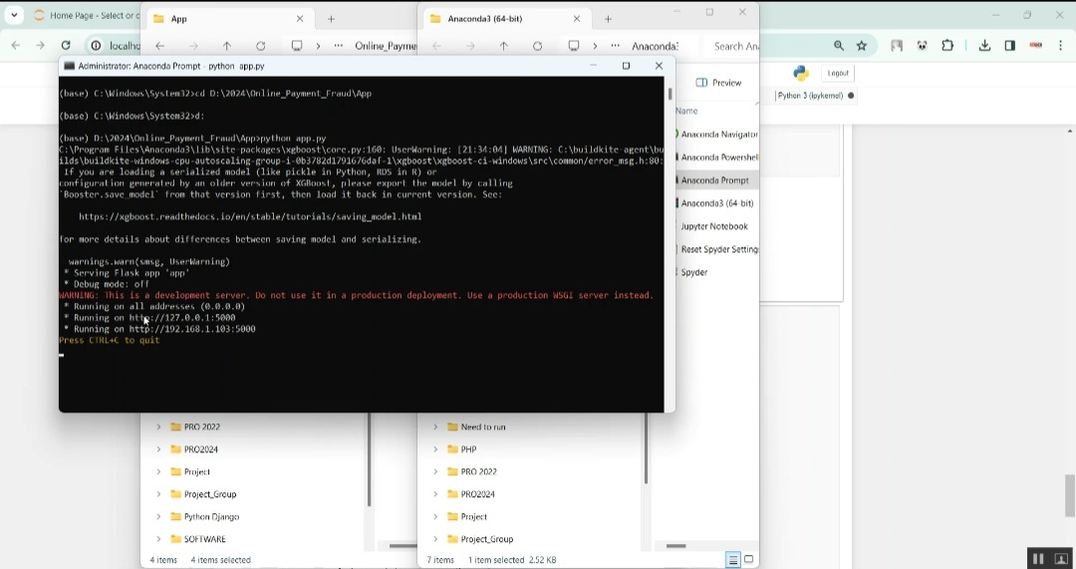
Screenshots

Slide 33
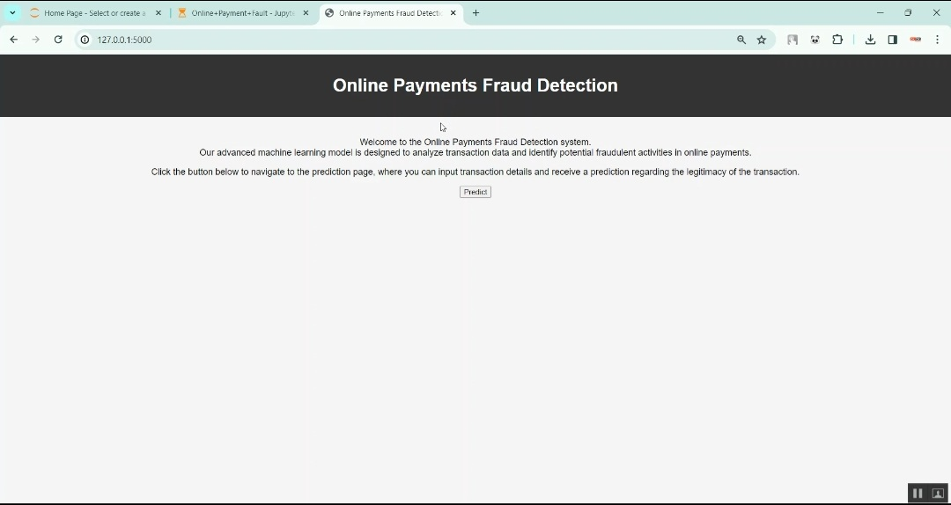

Slide 34
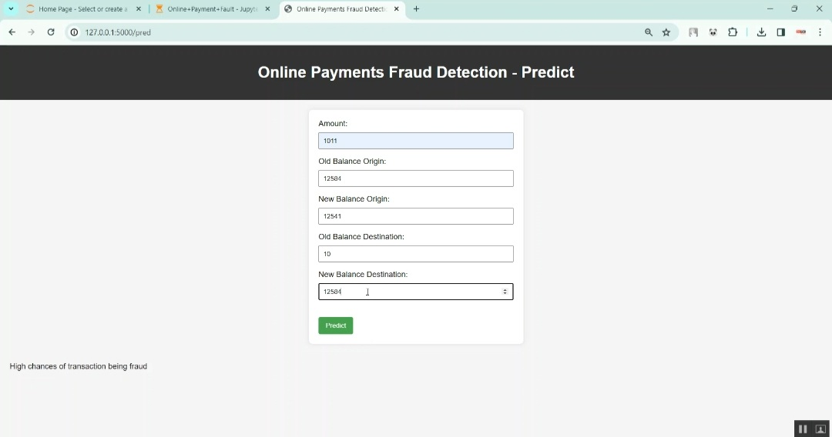

Slide 35
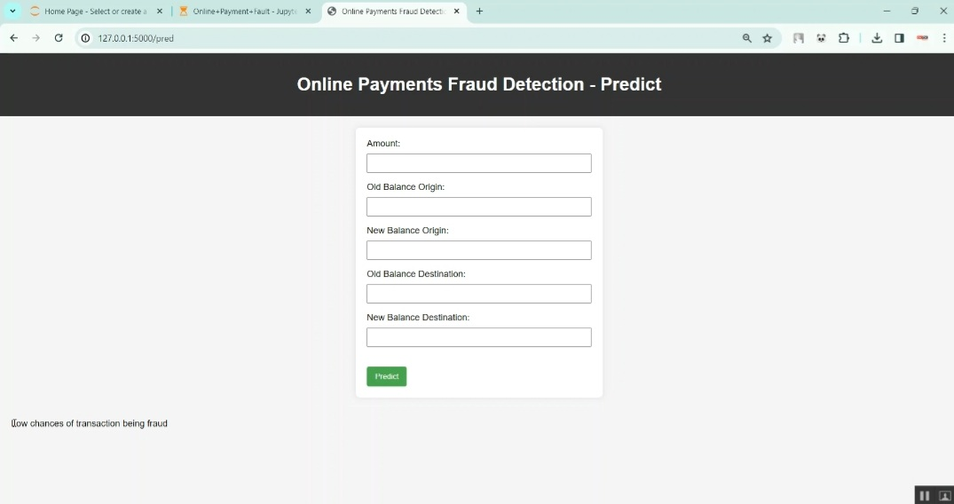

Slide 36
Conclusion
In conclusion, Leveraging machine learning for Fraud detection by strengthening online payment security, represents a pivotal advancement in securing digital transactions and safeguarding financial ecosystems.
Through the application of supervised learning algorithms, ensemble techniques, deep learning architectures, and innovative methodologies, machine learning-based fraud detection systems have demonstrated remarkable efficacy in identifying and mitigating fraudulent activities in real-time.

Slide 37
References
Good Teachers are worth more than thousand books, we have them in Our Department:
References Made From:
User Interfaces in C#: Windows Forms and Custom Controls by Matthew MacDonald.
Applied Microsoft® .NET Framework Programming (Pro-Developer) by Jeffrey Richter.
Practical .Net2 and C#2: Harness the Platform, the Language, and the Framework by Patrick Smacchia.
Data Communications and Networking, by Behrouz A Forouzan.
Computer Networking: A Top-Down Approach, by James F. Kurose.
“The Apache Cassandra project,” http://cassandra.apache.org/.

Slide 38
Sites Referred:
http://www.sourcefordgde.com
http://www.networkcomputing.com/
http://www.ieee.org
http://www.emule-project.net/

Slide 39


